Slide 1

CSE-104 (LAB)-DE
LAB PROJECT

Slide 2
Green University of Bangladesh
Lab Project Report
Title: Structured Programming Lab
Course Title: CSE-104
Submitted To:
Course Teacher Name: Md. Gulzar Hussain
Designation: Lecturer
Department: Department of Computer Science and Engineering
Submitted By
Name: Md. Rumman Hossain Juwel
ID: 193002151
Name: Sheikh Md Asifur Rahman
ID: 193002111
Name: Indronil Roy Ratul
ID: 193002135
Name: Md. Sabbir Ahmed
ID: 193002115
Department: Department of Computer Science and Engineering
Date of Submission: 24 October 2020

Slide 3
TABLE OF CONTENTS
1. Introduction….……………………..4-5
2. Theory …………………………......6-9
3. Requirements.………….…….…….....9
4. Experiment with solution……........9-16
5. Conclusions ………………………...17
6. References ………………………….17

Slide 4
INTRODUCTION
C is a general-purpose high level language that was originally developed by Dennis Ritchie for the Unix operating system. It was first implemented on the Digital Equipment Corporation PDP-11 computer in 1972.
The Unix operating system and virtually all Unix applications are written in the C language. C has now become a widely used professional language for various reasons.
- Easy to learn
- Structured language
- It produces efficient programs.
- It can handle low-level activities.
- It can be compiled on a variety of computers.
#Facts about C:
C was invented to write an operating system called UNIX.
C is a successor of B language which was introduced around 1970
The language was formalized in 1988 by the American National Standard Institute (ANSI).
By 1973 UNIX OS almost totally written in C.
Today C is the most widely used System Programming Language.
Most of the state of the art software have been implemented using C

Slide 5
Why to use C ?
C was initially used for system development work, in particular the programs that make-up the operating system. C was adopted as a system development language because it produces code that runs nearly as fast as code written in assembly language. Some examples of the use of C might be:
- Operating Systems
- Language Compilers
- Assemblers
- Text Editors
- Print Spoolers
- Network Drivers
- Modern Programs
- Data Bases
- Language Interpreters
- Utilities

Slide 6
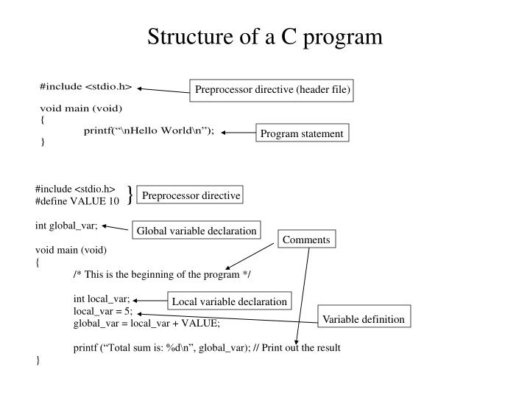
Theory
C language is a very good language to introduce our self to the programming world, as it is a simple procedural language which is capable of doing wonders.
Beginning with C programming:
1. Structure of a C program After the above discussion, we can formally assess the structure of a C program. By structure, it is meant that any program can be written in this structure only. Writing a C program in any other structure will hence lead to a Compilation Error. The structure of a C program is as follows:

Slide 7
The components of the above structure are:
Header Files Inclusion: The first and foremost component is the inclusion of the Header files in a C program. A header file is a file with extension .h which contains C function declarations and macro definitions to be shared between several source files. Some of C Header files:
stddef.h – Defines several useful types and macros.
stdint.h – Defines exact width integer types.
stdio.h – Defines core input and output functions
stdlib.h – Defines numeric conversion functions, pseudo-random network generator, memory allocation
string.h – Defines string handling functions
math.h – Defines common mathematical functions.
Syntax to include a header file in C:
#include
2. Main Method Declaration: The next part of a C program is to declare the main() function. The syntax to declare the main function is:Syntax to
Declare main method:
int main()
{}

Slide 8
3. Variable Declaration: The next part of any C program is the variable declaration. It refers to the variables that are to be used in the function. Please note that in the C program, no variable can be used without being declared. Also in a C program, the variables are to be declared before any operation in the function.
Example:
int main()
{
int a; . .
4. Body: Body of a function in C program, refers to the operations that are performed in the functions. It can be anything like manipulations, searching, sorting, printing, etc.
Example:
int main()
{
int a;
printf("%d", a);
.
.
5. Return Statement: The last part in any C program is the return statement. The return statement refers to the returning of the values from a function. This return statement and return value depend upon the return type of the function. For example, if the return type is void, then there will be no return statement. In any other case, there will

Slide 9
be a return statement and the return value will be of the type of the specified return type.
Example:
int main()
{
int a;
printf("%d", a);
return 0;
} .
3) Requirements:
a. A desktop or laptop Computer,
b. A proper compiler. Here, we used CodeBlocks.
4) Experiments with proper Solutions:
a. write a program in Code Blocks to Search
element from Array
b. Write a 2 diminution array in Code Blocks
c. Write a program to find reverse output against
any input

Slide 10
/* write a program in Code Blocks to Search element from Array . */
// input output header file
#include<stdio.h>
int main()
{
// Data type declare
int arr[100], c, n, i; // arr[100] = array size initialization
printf(" \t enter element of Array size : \n");
scanf("%d",&n);
for (i=0; i<n; i++) // Using loop for input of array element
{
scanf("%d",&arr[i]);
}
printf(" \t enter the array Search of element : ");
scanf("%d",&c);
for (i=0; i<n; i++) // using loop for continue condition lots of time
{
if (arr[i]==c)
{
printf(" \t\t\t %d is Location from Array = %d \n",c,i+1 );
break;
}

Slide 11
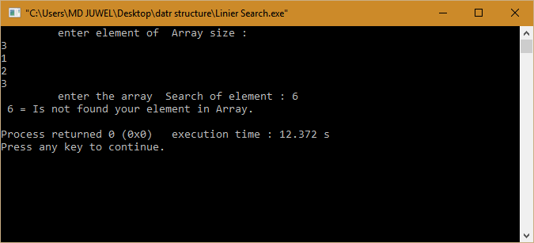
else {
printf(" %d = Is not found your element in Array. \n ",c);
}
}
return 0;
}

Slide 12
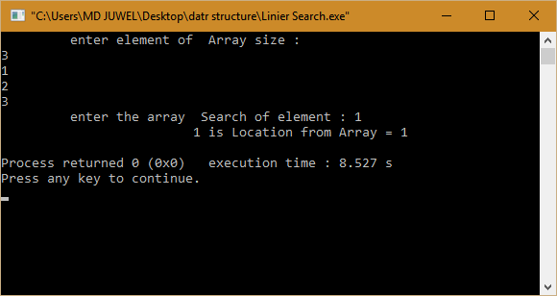

Slide 13
/* Write a 2 diminution array in Code Blocks */
//Input output Header file
#include<stdio.h>
// main body which compiler write first
int main()
{ /* Deta type */
int a[3][4]; /* Integer Array for 2D which call Row and Collum */
int row,col;
printf("Enter value for 2D Array : \n");
printf("Input 3 for Row x 4 for Collum: \n");
for (row=0; row<3; row++) /* for loop use for input value from user and stor mamory of Array */
{
for (col=0; col<4; col++) // Nestted loop used
{
scanf("%d",&a[row][col]);
}
}
for (row=0; row<3; row++) /* Again loop for print */
{
for (col=0; col<4; col++) // Nestted loop for print
{
printf(" \t %d ",a[row][col]);
}
printf("\n"); }
}

Slide 14
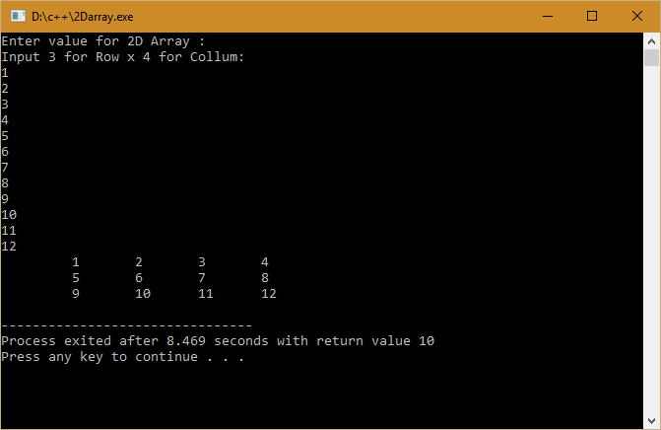

Slide 15
//Write a program to find reverse output against any input .
// Header File
#include<stdio.h>
int main() // main body.
{
while (1) /* while(1) is this program is always true... and check time . */
{ /* Deta type Declaration and some integer variable */
int num, temp, r, sum=0;
printf(" enter any number : ");
scanf("%d",&num); /* Input from User this call Dinamic input */
temp = num; // num variable assingne in temp variable
while (temp!=0) /* this loop continue bfore temp value is Zero (0) */
{
r = temp %10; // Mudulas value assingne in R variable
sum = sum*10 +r; // Assingment oparator used
temp = temp /10; // Assingment oparator used
}
printf(" \t\t Revers number %d \n",sum);
}
/* We cannot used return 0 becouse while(1) and that's why we check many time this program. */
}

Slide 16
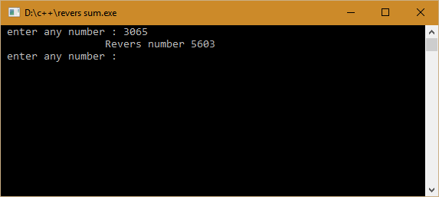

Slide 17
5) Conclusions:
For Beginners, C programming is not that easy to learn and apply. We are trying to know the basic idea of c language and practice them properly.
6) References:
The Complete Reference C 4th Edition-By Herbert Schildt
https://en.wikipedia.org/wiki/C_(programming_language)
https://www.tutorialspoint.com/ansi_c/c_introduction.htm
https://www.geeksforgeeks.org/c-language-set-1-introduction/

